Slide 1
Information management lab (Views)

Slide 2
Views
In some cases, it is not desirable for all users to see the entire logical model (that is, all the actual relations stored in the database.)
Consider a person who needs to know a customer’s loan number but has no need to see the loan amount. This person should see a relation described, in SQL, by
(select customer_name, loan_number from borrower, loan where borrower.Loan_number = loan.Loan_number )

Slide 3
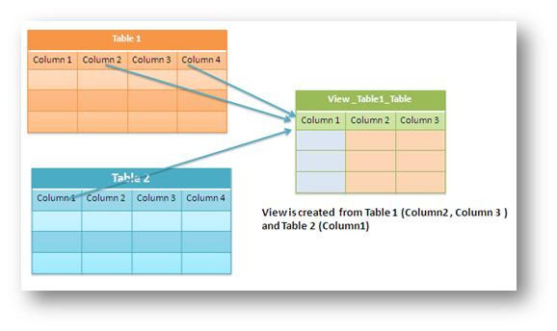
A view is a "virtual table". It is not like a simple table, but is a virtual table which contains columns and data from different tables (may be one or more tables)

Slide 4
View definition
An SQL View is a specific representation of data from one or more tables.
The tables referred in the views are known as base tables.
View is virtual relation that does not necessarily actually exist in the database but is produced upon request, at time of request.
Like a table, a view consists of a set of named columns and rows of data. Unless indexed, a view does not exist as a stored set of data values in a database.

Slide 5
Advantages of views
Security each user can be given permission to access the database only through a small set of views that contain the specific data the user is authorized to see
Query simplicity A view can draw data from several different tables and present it as a single table, turning multi-table queries into single-table queries against the view.
Structural simplicity views can give a user a "personalized" view of the database structure, presenting the database as a set of virtual tables that make sense for that user.
Consistency A view can present a consistent, unchanged image of the structure of the database, even if the source tables are split, restructured, or renamed.
Data integrity if data is accessed and entered through a view, the dbms can automatically check the data to ensure that it meets the specified integrity constraints.

Slide 6
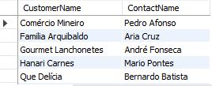
Create views
Syntax:
CREATE VIEW view_name AS SELECT column1, column2, ... FROM table_name WHERE condition;
Example
Query: Creates a view that shows all customers from brazil:
CREATE VIEW brazil_customers AS
SELECT customername, contactname
FROM customers
WHERE country = 'brazil';

Slide 7

Creating view from a single table:
Write a query to create a view for those employees belong to the department ID as 100 and display the view.
Create view department_100 as
Select * from employees
Where department_id=100;
Select * from department_100;

Slide 8
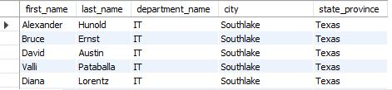
Creating view from multiple tables:
Write a query to create the view of first and last name, department, city, and state province for each employee
CREATE VIEW on_join as
SELECT e.first_name,e.last_name, d.department_name, l.city,l.state_province
FROM locations l join departments d using (location_id) join employees e using (department_id);
Select * from on_join;

Slide 9

Use VIEW as a table in another view
Write a query in SQL to create a view and display those employees who contain a letter z to their first name and also display their last name, department, city, and state province.
Create view search_on_join as
Select * from on_join
Where first_name like '%z%’;
Select * from search_on_join;
Note: View on_join is used with the select statement for the abovementioned query.

Slide 10
Update views
Conditions needed to be satisfied to update a view.
The select statement which is used to create the view should not include group by clause or order by clause.
The select statement should not have the distinct keyword.
The view should have all not null values.
The view should not be created using nested queries or complex queries.
The view should be created from a single table. If the view is created using multiple tables then we will not be allowed to update the view.

Slide 11
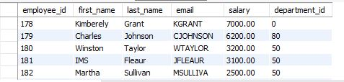
Update views example
Write a query to create a view for all employees with columns employee_id, name, email, salary and department ID.
Create view employee_updated as
select e.Employee_id, e.First_name, e.Last_name, e.Email, e.Salary, e.Department_id
from employees e;
select * from employee_updated;
Now UPDATE the employee first name as your first name whose employee_id is '181’
update employee_updated
set first_name='IMS’
where employee_id='181';

Slide 12
Delete views
If a created view is not needed then we can delete it.
We can delete or drop a view using the drop statement.
Example:
Drop view on_join;

Slide 13

Thank you..

